Slide 1

Nigeria and Foreign Aid (1960–2025):
Driving Growth or Deepening Dependency?
Student Number: R2203D13959657
MSc International Relations
Policy & Practice of Humanitarianism and Development (Mental Wealth) (89711)

Slide 2

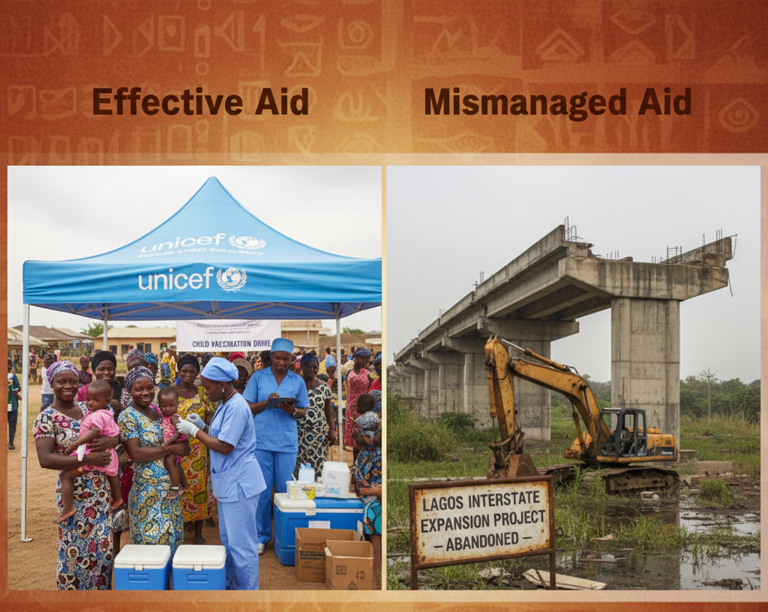
Introduction
In Nigeria, aid plays a vital role in stabilizing the economy during oil downturns by bridging budget gaps, sustaining essential services such as clinics and schools, and relief programs, while also attracting investment and enabling knowledge transfer for development. However, it can also create dependency, shift priorities toward donor interests, weaken domestic tax efforts, and distort the economy through tied projects and currency effects.
Student Number: R2203D13959657

Slide 3
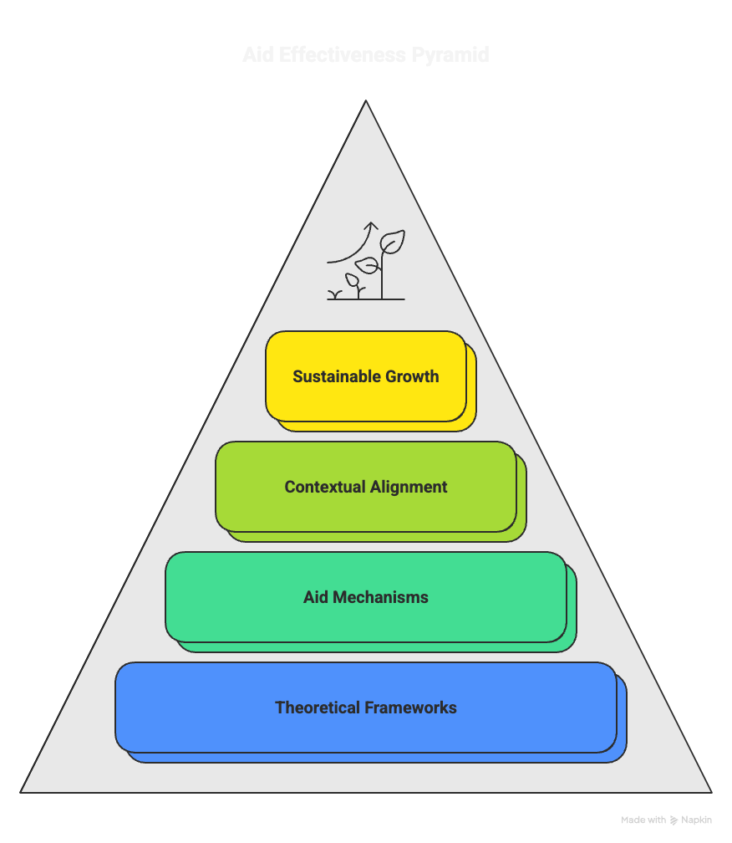
Theoretical Perspectives: Aid Driving Growth Potential
In a conducive environment, aid can catalyze development and produce measurable gains, even when economy-wide outcomes are uneven (Easterly, 2006). To translate these gains into broader growth, the priority is to crowd in the private sector by improving the business environment, scaling innovation, and strengthening the systems that enable entrepreneurship and investment.
Effectiveness improves when financing is anchored in country-owned, long-term strategies and reoriented toward productive sectors like agriculture, industry, and particularly energy and infrastructure (Kharas, 2010).
Student Number: R2203D13959657

Slide 4
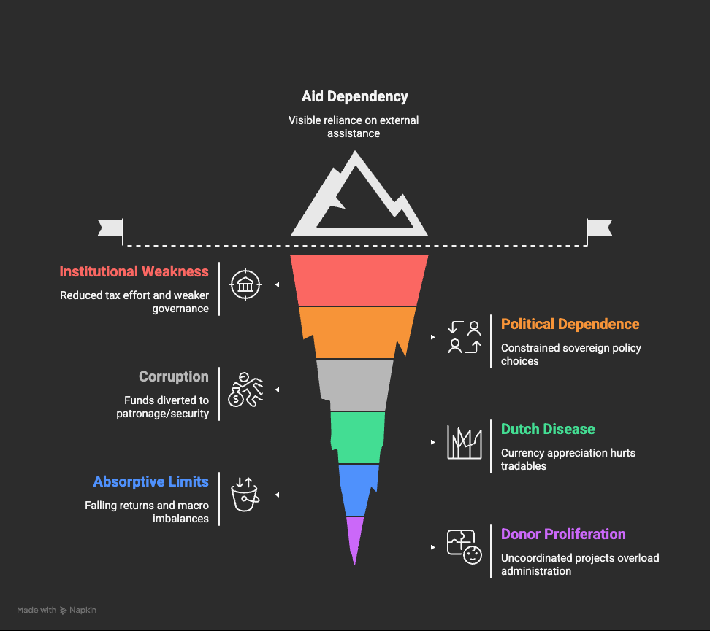
Theoretical Perspectives: Aid Risks of Dependency
Aid institutions paradox: large inflows reduce tax effort and shift accountability to donor governance (Moyo, 2009).
Political dependence: permanent negotiation with donors constrains sovereign policy choices (Whitfield, 2009).
Fungibility & corruption: aid substitutes domestic spend; freed funds diverted to patronage/security (Newby, 2010).
Donor proliferation: many uncoordinated projects overload admin and fragment policy (Whitfield, 2009).
Student Number: R2203D13959657

Slide 5
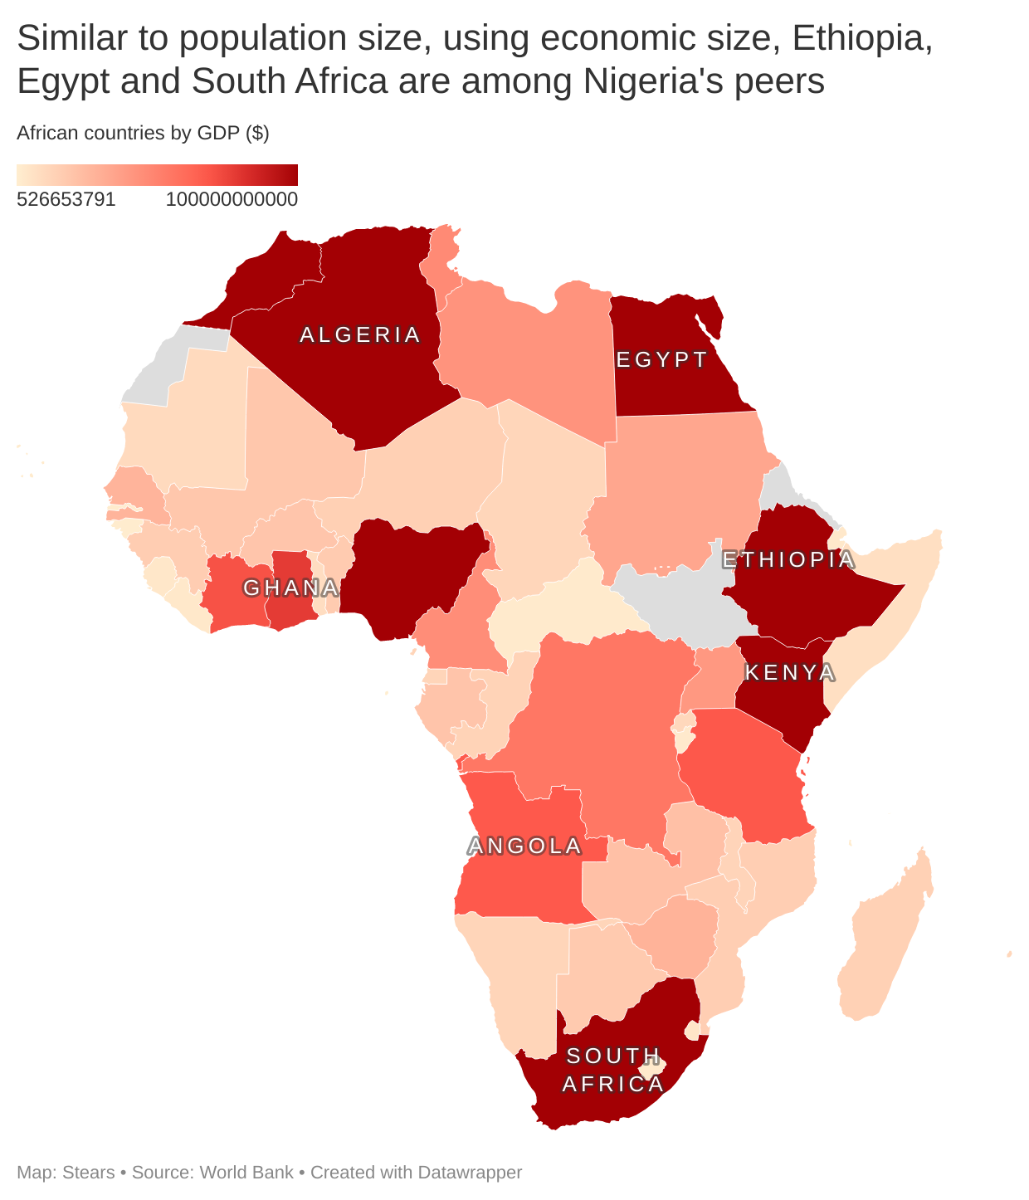
Nigeria’s Development Trajectory
Opportunity story: As Okonjo-Iweala argues, SSA (incl. Nigeria) outpaced Brazil/India in the 2000s; Nigeria can be a new engine of global demand.
Big-market fundamentals: Large population, oil/gas, and urbanization. If aid aligns with infrastructure & productive sectors, it can catalyze gains.
Country-owned strategy: Support Nigeria-led plans, not one-size-fits-all, think the “Botswana model”
Student Number: R2203D13959657

Slide 6
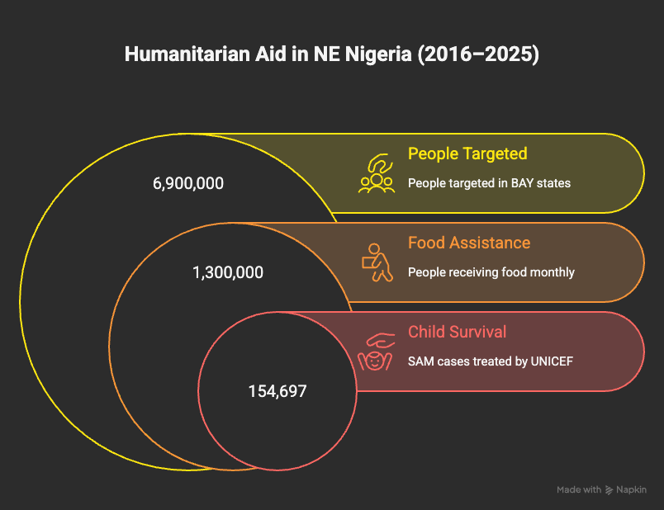
Humanitarian Aid in Nigeria (2016–2025): Lives Saved, Hunger Averted
Mass needs, scaled response: 2017 HRP targeted 6.9M in Bayelsa state; famine averted.
Child survival: UNICEF treated 154,697 SAM cases (H1 2022).
Pooled funding: NHF accelerated front-line NGO response.
Student Number: R2203D13959657

Slide 7
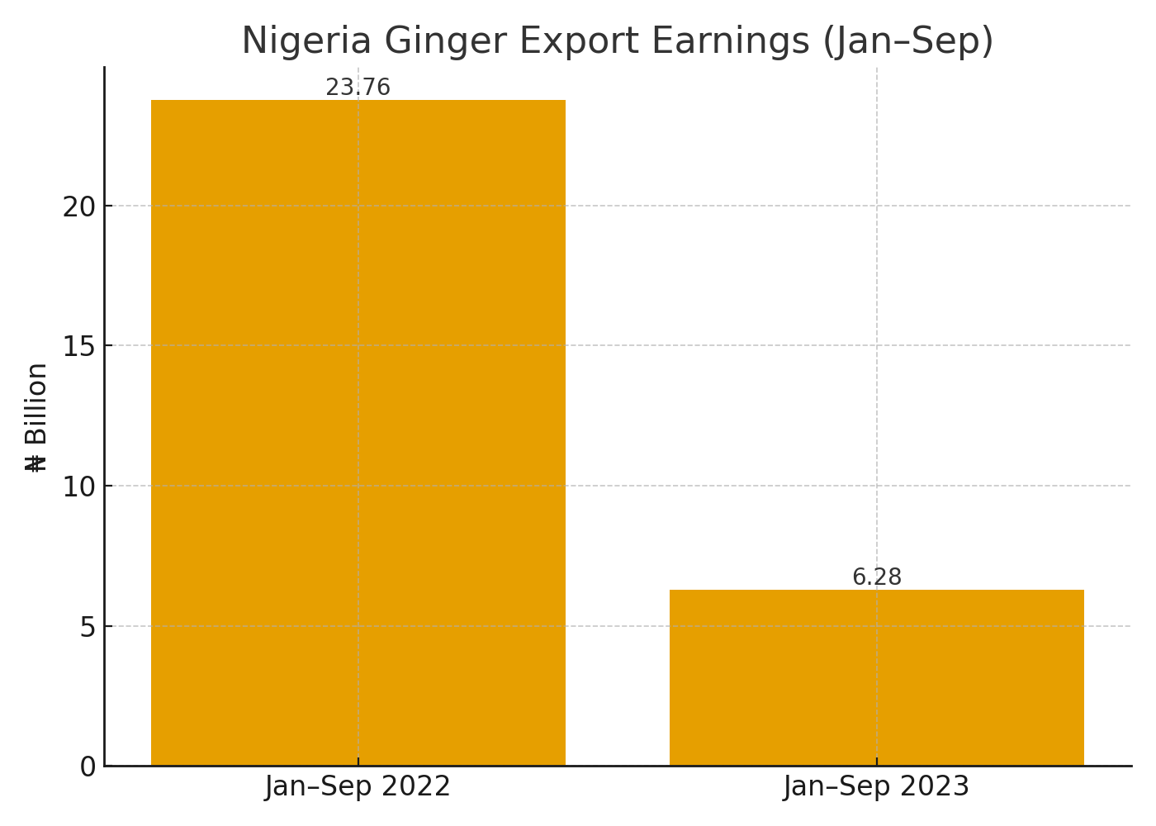
Donor-Led Agricultural Interventions: Ginger in Southern Kaduna (Boom → Bust)
Southern Kaduna (Kachia LGA) became Nigeria’s ginger hub; output surged (2017–2021) and Nigeria briefly ranked #3 globally.
The 2023 fungal outbreak (Pyricularia zingiberis) devastated farms (~85% loss), crashing exports and spiking local prices.
Takeaway: seed distribution without strong local systems (clean seeds, extension, surveillance) amplifies risk.
Student Number: R2203D13959657

Slide 8
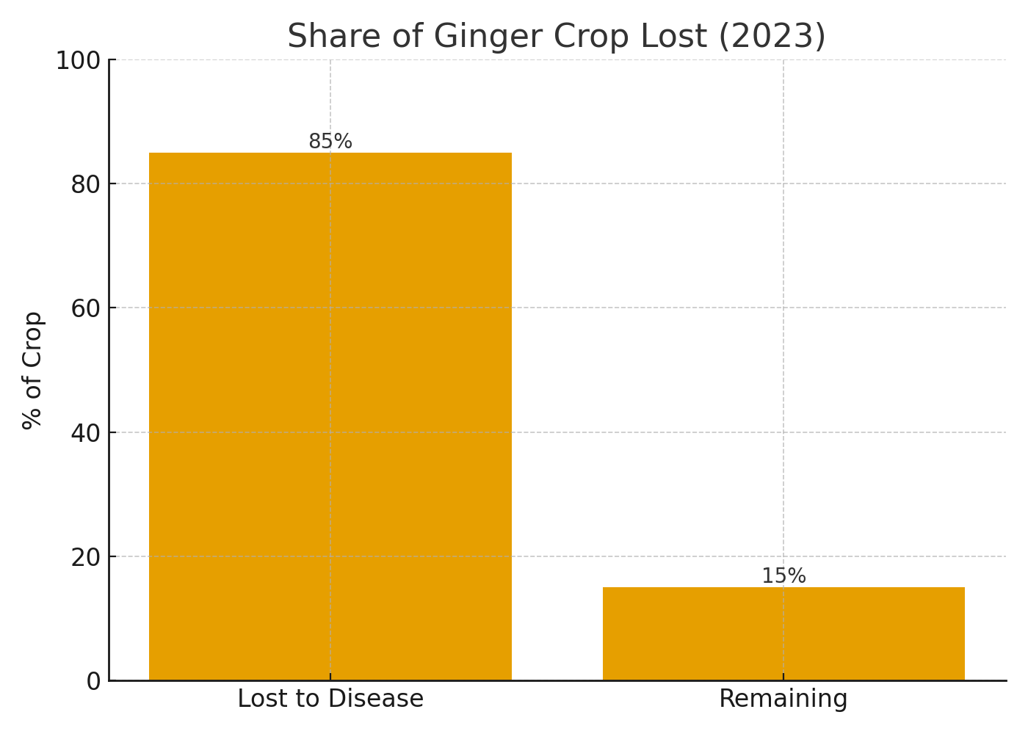
What Went Wrong & What To Fix
Risk: Donor-led seed pushes, weak extension, and poor disease surveillance left farmers exposed.
Market Shock: Jan–Sep export earnings fell ~74% (₦23.76bn to ₦6.28bn); a 50 kg bag jumped ~₦50k to ₦800k.
Fixes: Invest in disease-resistant clean seeds; strengthen extension & diagnostics; provide farmer training; and develop resilient value-chains.
Student Number: R2203D13959657

Slide 9
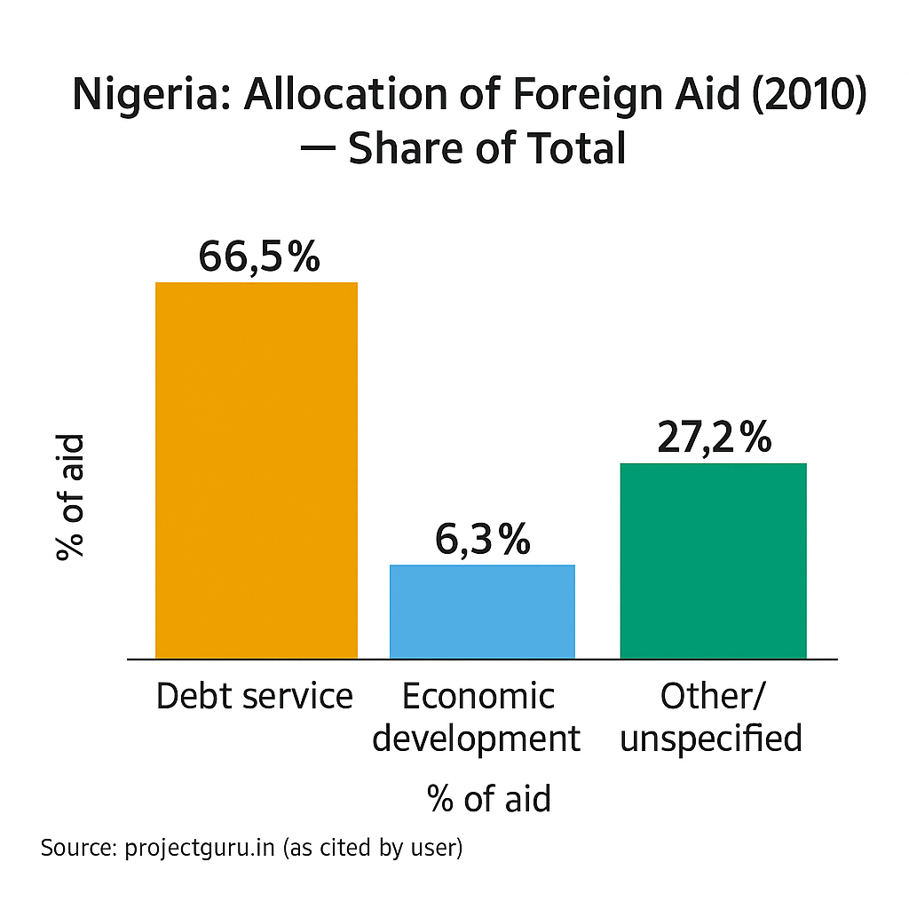
Foreign Aid’s Destruction of Nigeria’s Institutions
Accountability erosion: governments' initial response to donors leads to a weaker social contract.
Leakages & graft: aid diverted, parallel units starve clinics/schools.
Distorted priorities: securitized, donor-driven spending crowds out reforms/services.
Debt dependence: loan-heavy aid and debt service crowd out investment.
Student Number: R2203D13959657

Slide 10
Key Challenges:
Micro ≠ Macro: project wins, modest national gains (Easterly, 2006).
Fragmentation: 20+ donors/projects leads to duplication, high admin load (Whitfield, 2009).
Sector skew: social spend up; productive sectors (power, agri, industry) underfunded.
Rigid delivery: slow, inflexible cycles miss planting/market windows (Nelson, 2010).
Weak ownership: donor-pleasing plans, low local buy-in.
Leakages: illicit flows & capital flight blunt impact (IIEA 2017).
Student Number: R2203D13959657

Slide 11
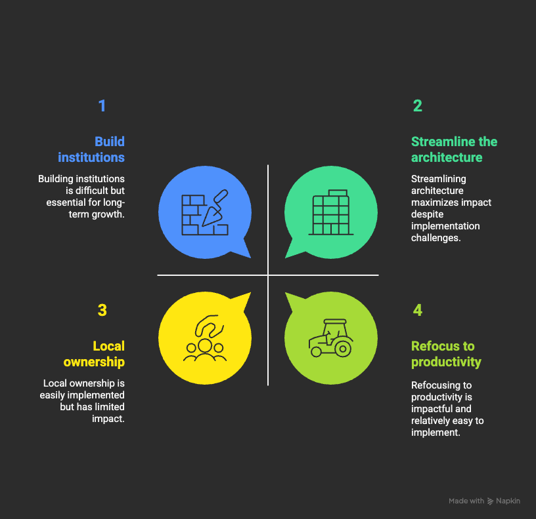
Pathways to Sustainable Growth
Nigeria in the driver’s seat: donors align to Nigeria-led priorities (Botswana style ownership).
Refocus on productivity: channel aid to agriculture, industry, and power/infra (tackle core bottlenecks).
Build institutions (not bypass): use aid to upgrade PFM, procurement, civil service; smart budget support/debt relief with anti-corruption safeguards.
Local ownership: co-design with communities/civil society; community-driven development for durability.
Student Number: R2203D13959657

Slide 12
Conclusion:
Foreign assistance has saved lives, expanded schooling and immunization, and cushioned crises, yet it has not delivered a sustained national take-off. The line between aid driving growth and deepening dependency shifts by period and sector, underscoring a core lesson: incentives and institutions, not sheer aid volume, determine outcomes.
The path forward is to treat aid as a temporary catalyst with an “expiry date.” Nigeria sets the agenda, and donors provide support. That means channeling support to productive capacity (power, agriculture, industry), building resilient public institutions and domestic revenues, and choking off leakages and illicit flows.
Student Number: R2203D13959657

Slide 13
References
Centre for Humanitarian Leadership (2021) “Community-Led Humanitarian Action in Crisis: Rethinking Aid Governance.” [YouTube video, 15 March 2021]. (Accessed: 10 Sep 2025).
Derviş, K. and Milsom, S. P. (2010) ‘Responding to a Changing Climate: Challenges in Financing Climate-Resilient Development Assistance’, in Making Development Aid More Effective: 2010 Brookings Blum Roundtable. Washington, DC: Brookings, pp. 37–47.
IIEA (2017) Y. Karitanyi, “Good Governance and Sustainable Development – Rwanda’s Perspective.” Institute of International & European Affairs, [Video lecture]. (Accessed: 10 Sep 2025).
Kharas, H. (2010) ‘Can Aid Catalyze Development?’, in Making Development Aid More Effective: 2010 Brookings Blum Roundtable. Washington, DC: Brookings, pp. 3–9.
Kharas, H. (2010) ‘Rethinking the Roles of Multilaterals in the Global Aid Architecture’, in Making Development Aid More Effective: 2010 Brookings Blum Roundtable. Washington, DC: Brookings, pp. 55–62.
Moyo, D. (2009) Dead Aid: Why Aid Isn’t Working and How There Is a Better Way for Africa. London: Penguin.
Student Number: R2203D13959657

Slide 14
Nelson, J. (2010) ‘The Private Sector and Aid Effectiveness: Toward New Models of Engagement’, in Making Development Aid More Effective: 2010 Brookings Blum Roundtable. Washington, DC: Brookings, pp. 20–27.
Newby, T. M. J. (2010) Unintended Effects of Development Aid – A Brief Overview. DIIS Working Paper 2010:06. Copenhagen: Danish Institute for International Studies.
Okonjo-Iweala, N. (2010) Speech at Harvard University (John F. Kennedy School of Government), April 2010. Quoted in Kharas (2010).
TEDx Talks (2015) “In Defence of Foreign Aid” – Joe Cerrell, TEDxASL [YouTube video]. (Accessed: 8 Sep 2025).
TEDx Talks (2012) “The Paradox of Humanitarian Aid” – Fiona Terry, TEDxRC2 [YouTube video]. (Accessed: 8 Sep 2025).
Whitfield, L. (2009) Reframing the Aid Debate: Why Aid Isn’t Working and How It Should be Changed. DIIS Working Paper 2009:34. Copenhagen: Danish Institute for International Studies. (Accessed: 10 Sep 2025).
Student Number: R2203D13959657

Slide 15
Williams, E. & Easterly, W. (2016) “The Aid Effectiveness Debate: Did We Learn Anything?” (Center for Global Development Essay). Washington, DC: CGD. (Includes Easterly’s reflections on the micro-macro paradox.)
Worthington, S. A. and Pipa, T. (2010) ‘International NGOs and Foundations: Essential Partners in a New Aid Architecture’, in Making Development Aid More Effective: 2010 Brookings Blum Roundtable. Washington, DC: Brookings, pp. 63–70.
​​This presentation was created with the help of Grammarly for proofreading, google slide / google Gemini for images and ChatGPT for guidance.
Student Number: R2203D13959657

